Slide 1

Sprint 1
Purple Dragons

Slide 2
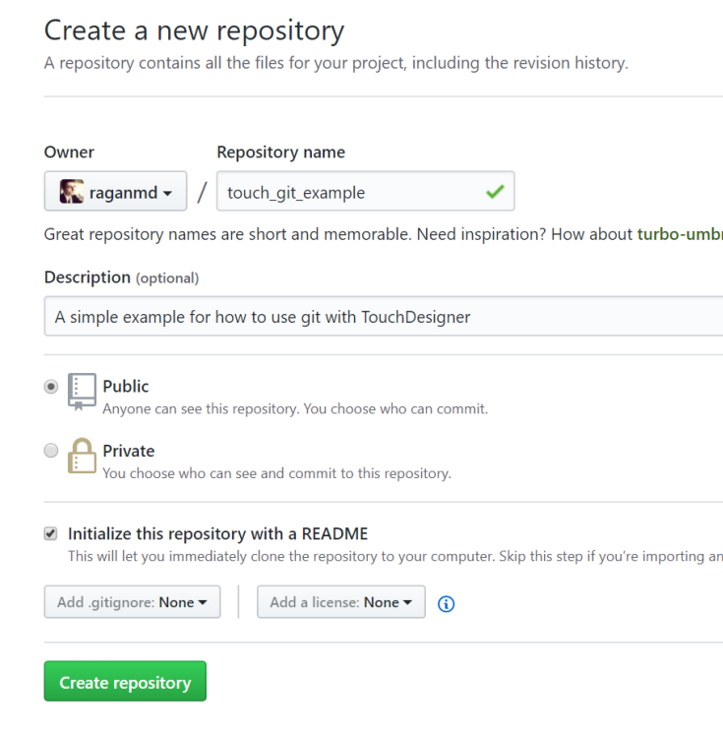
Initial set up

Slide 3
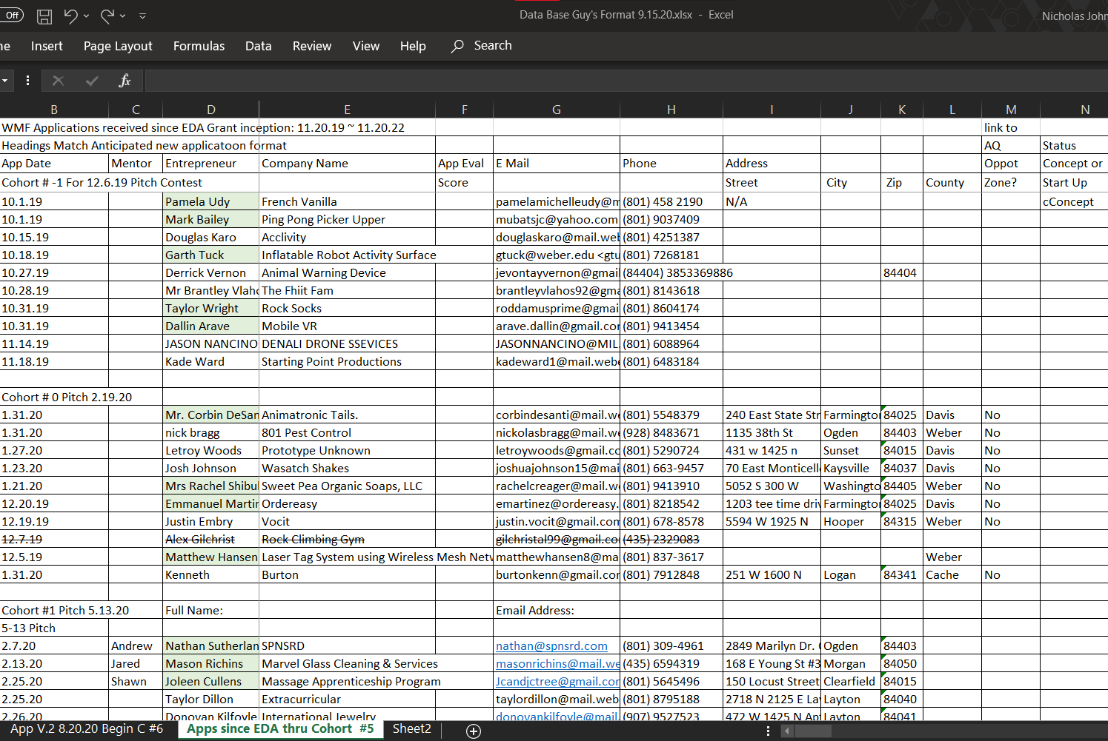
Excel Spreadsheet models part 1

Slide 4
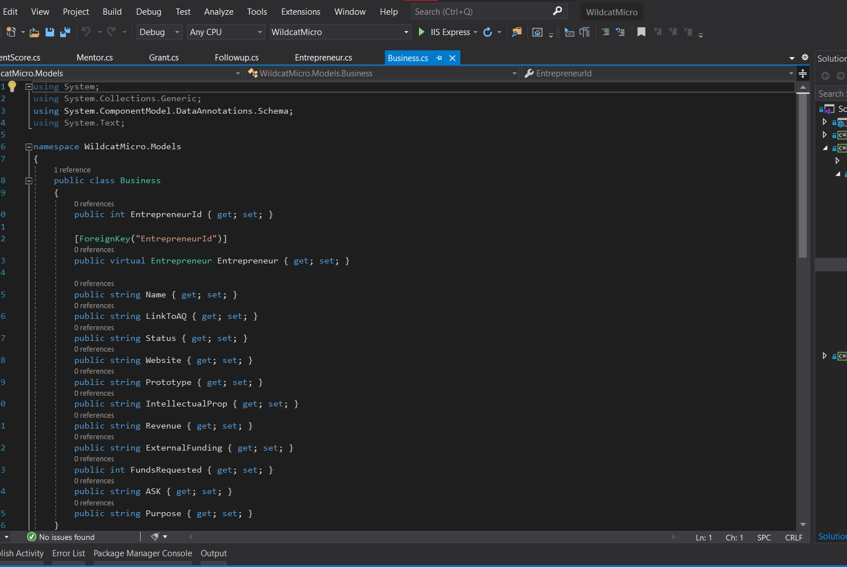
Excel Spreadsheet Models Part 2

Slide 5
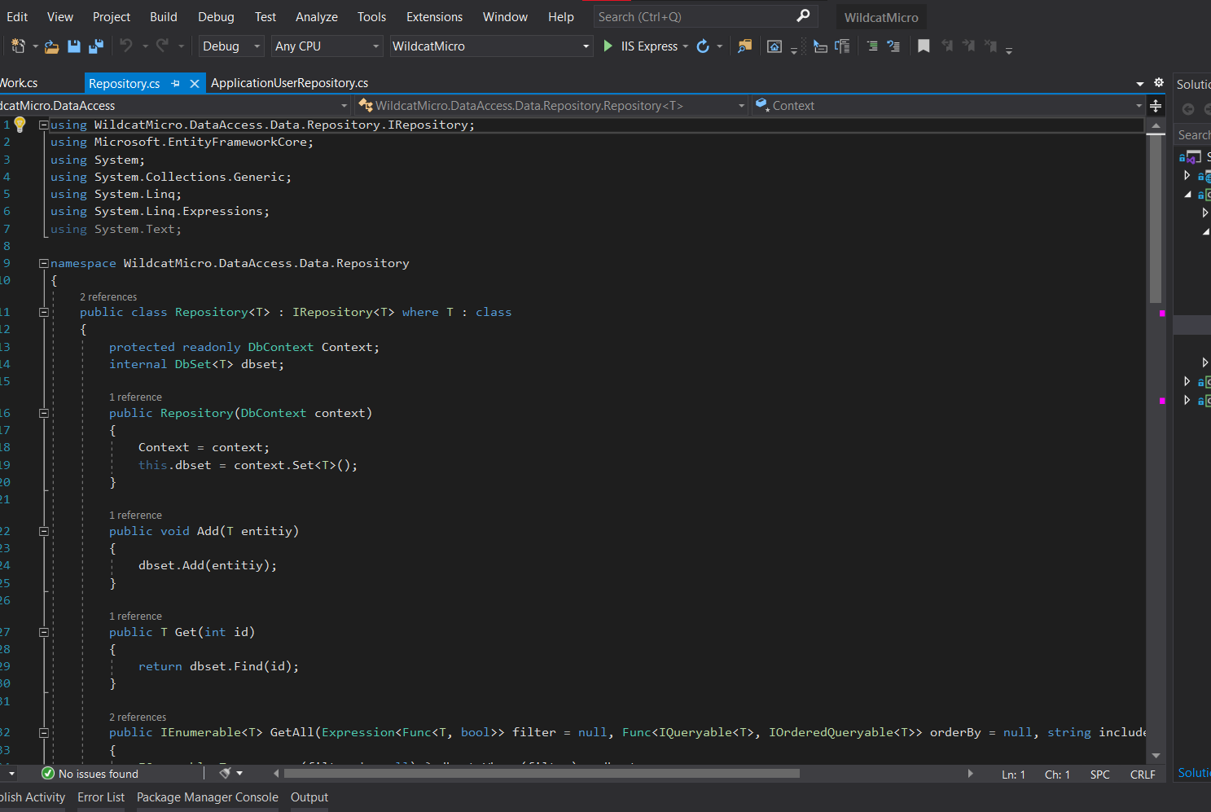
Repository Management

Slide 6

Looking ahead

